Slide 1

🦆🦆🦆
Daphne, Suinan, Ethan, Teo, and Jose
Tackle Quandela’s Toughest Challenge…
🦆🦆🦆
🦆🦆🦆

Slide 2


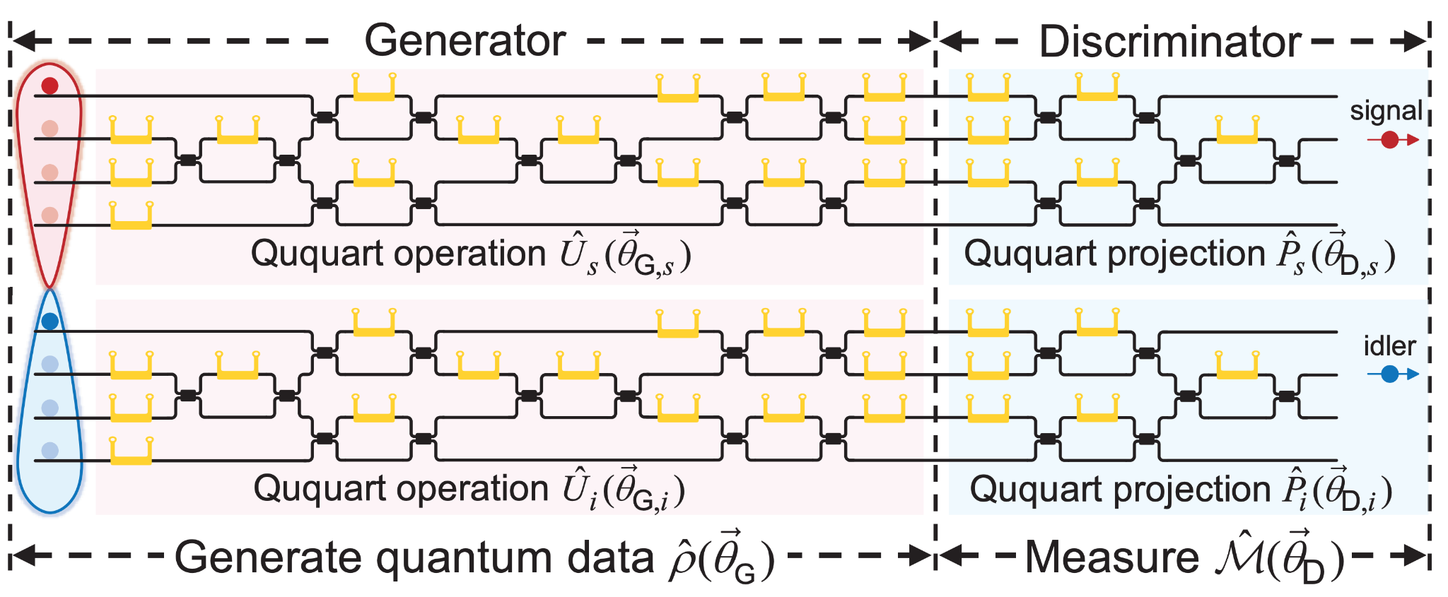


The PROBLEM
Train a Generator to produce the state
From the maximally entangled state
Using this Quantum Generative Adversarial Network Photonic (QGAN) Architecture:
Quandela’s Challenge
Notes:
Explain Qudit notation and Photonic Architecture. MMI (multi-mode interferometer) is BS and Heater is phase shifter.

Slide 3
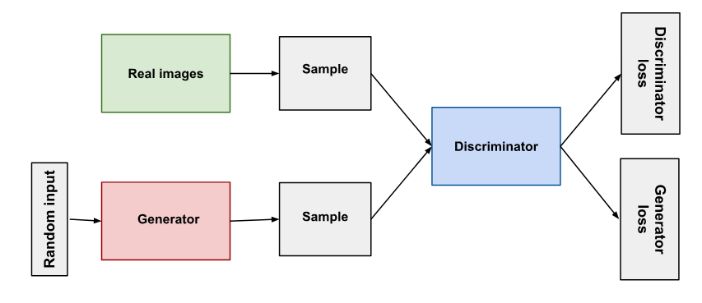
What is a QGAN?
In a GAN, the Generator generates fake data that’ll act as examples for the Discriminator.
The Discriminator distinguishes fake data from real data and penalizes the generator for bad results through backpropagation.
As training continues, the Generator gets better at creating data and the Discriminator gets worse at distinguishing between real and fake data. The two systems are trained simultaneously via competition.
A QGAN does this in a Quantum Mechanical system!
Real Data
https://developers.google.com/machine-learning/gan/gan_structure

Slide 4

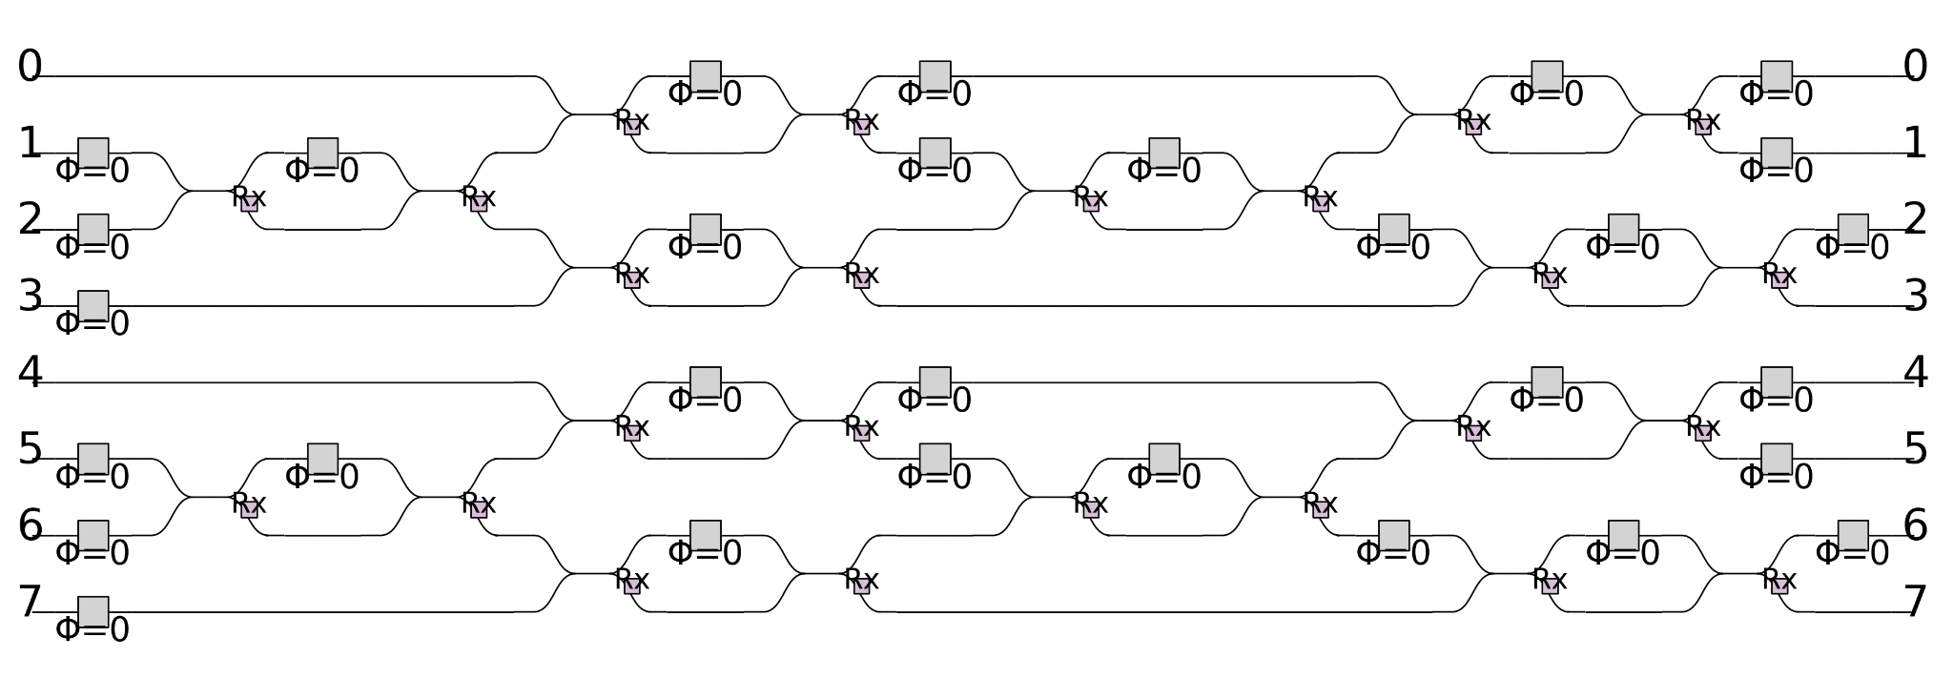
The Process
Step 1
Recreate the Circuit using Perceval
Perceval is a Python API specifically for Quantum Computing using Linear Optics!
Start with placeholder values for Phase shifters
‘MMI’ in paper is the Rx Beam splitter in Perceval

Slide 5


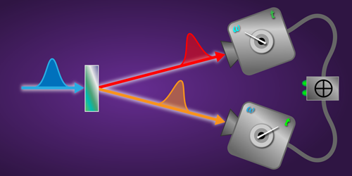
The Process
Step 2
Generate the initial entangled state
Use Perceval’s StateVector class
Created by adding 4 BasicStates corresponding to the entangled modes of the two photons
https://physics.aps.org/articles/v11/s14

Slide 6
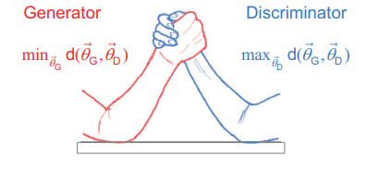
The Process
Final Step
Train the QGAN using the Variational Approach
Utilize Gradient Descent to optimize the rotation angle parameters to minimize the difference between the expectation values of the true data and the candidate quantum state

Slide 7
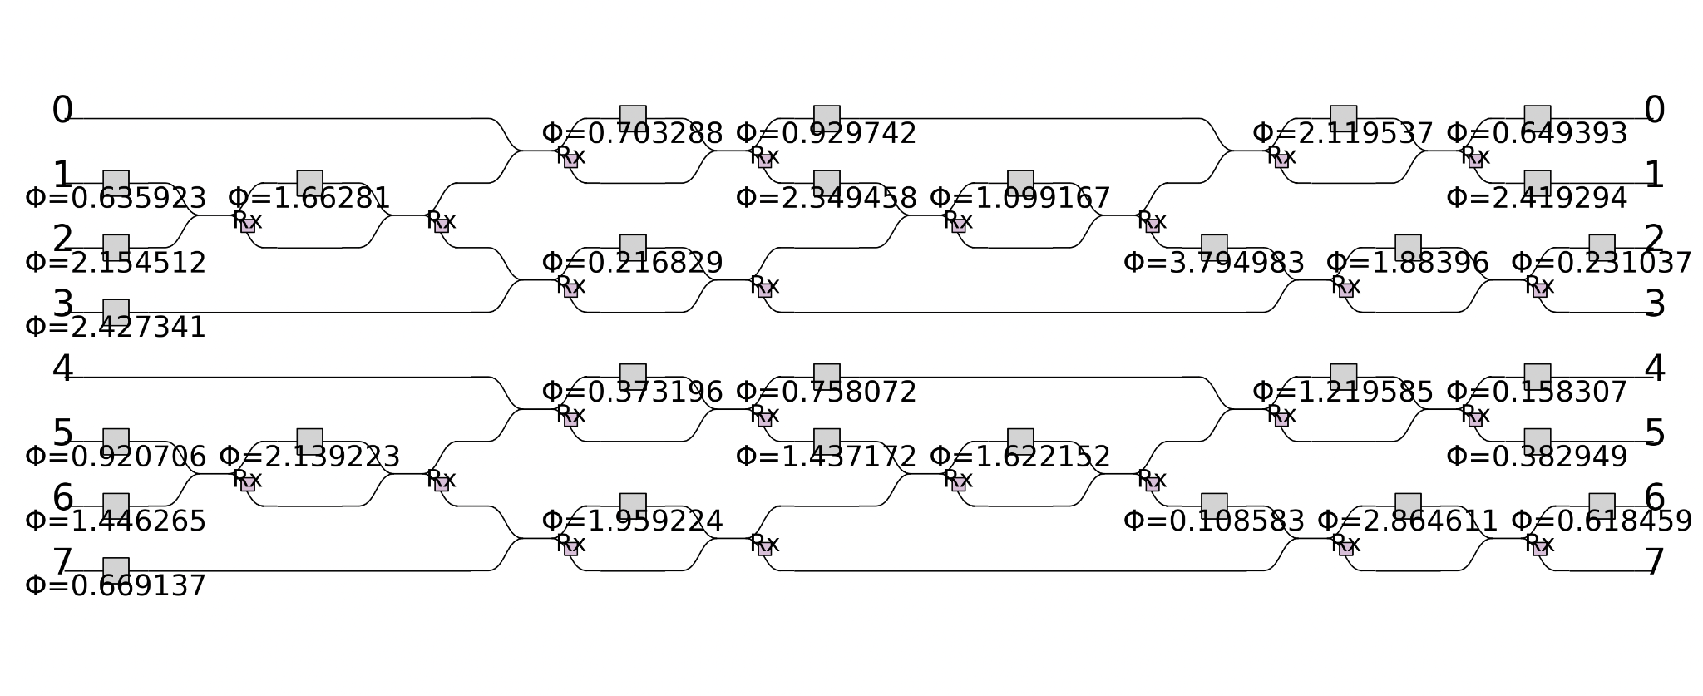
Non-Adversarial Training

Slide 8
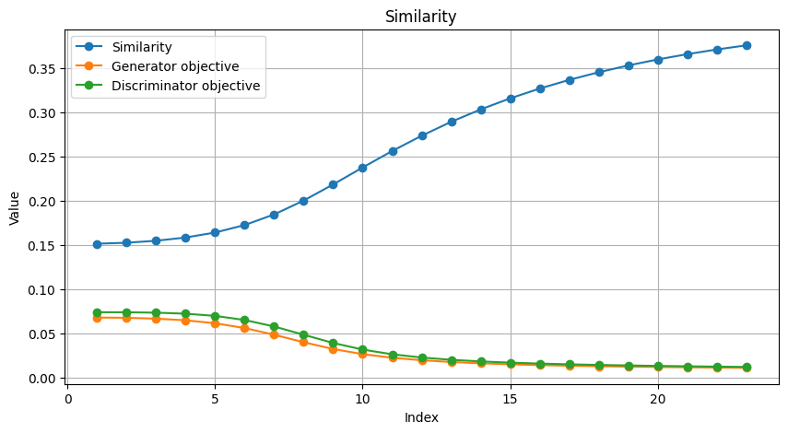
Results of Training

Slide 9
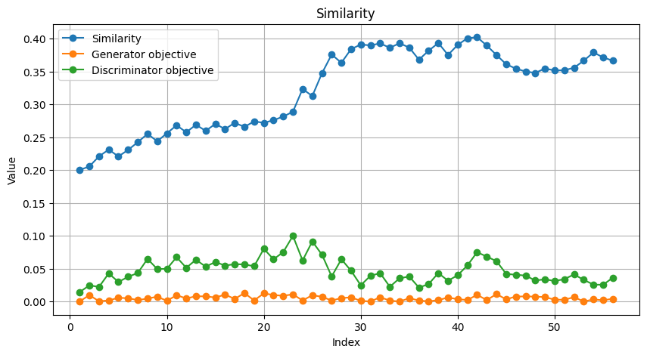
Results of Training

Slide 10
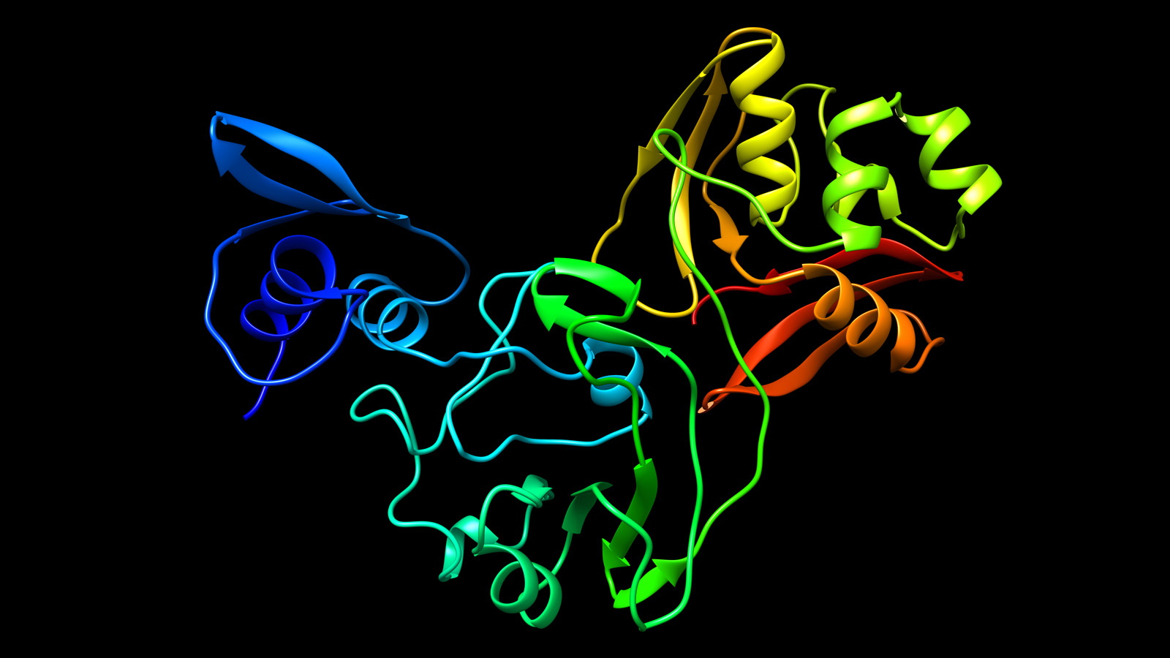
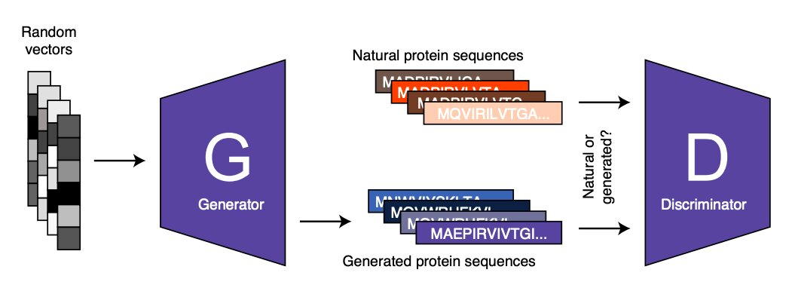
Future Applications
Variational Quantum Algorithm have the potential to be more efficient than their classical counterparts
Expand and improve on existing classical applications
Protein Folding Analysis
Pharmaceutical discoveries
Simulation of molecules in reasonable amounts of time

Slide 11
Questions?

